Slide 1

CS4157
Software Quality
Notes:
CS5707 Software Development Paradigms
John Dawson
CS5707 Software Development Paradigms
John Dawson
CS5707 Software Development Paradigms
John Dawson

Slide 2
Last Week
Configuration Management
Notes:
CS5707 Software Development Paradigms
John Dawson
CS5707 Software Development Paradigms
John Dawson
CS5707 Software Development Paradigms
John Dawson

Slide 3
Lecture Outline: Week 9 – 19th March
What is Defect Prevention?
Why Defect Prevention?
Defensive Programming
Software Transformation
Notes:
CS5707 Software Development Paradigms
John Dawson
CS5707 Software Development Paradigms
John Dawson
CS5707 Software Development Paradigms
John Dawson

Slide 4
What is Defect Prevention 1?
“A strategy applied to the software development life cycle that identifies root causes of defects and prevents them from recurring”
Origin in (post-war) Japanese manufacturing; associated with TQM (Total Quality Management)
Notes:
CS5707 Software Development Paradigms
John Dawson
CS5707 Software Development Paradigms
John Dawson
CS5707 Software Development Paradigms
John Dawson

Slide 5
What is Defect Prevention 2?
Principles of Defect Prevention:
Developers evaluate their own errors
Feedback is an essential component
There is no single cure-all
SPI in an integral part of the process
SPI takes times to learn
(Watts Humphrey)
Notes:
CS5707 Software Development Paradigms
John Dawson
CS5707 Software Development Paradigms
John Dawson
CS5707 Software Development Paradigms
John Dawson

Slide 6
What is Defect Prevention 3?
Types of Defect Prevention (DP)
DP as bug management: concen-trate on finding, logging & fixing
DP as a driver for change: analyse defects ⇨ improve process
DP as process / techniques / tools for preventing problems
Notes:
CS5707 Software Development Paradigms
John Dawson
CS5707 Software Development Paradigms
John Dawson
CS5707 Software Development Paradigms
John Dawson

Slide 7
Lecture Outline
What is Defect Prevention?
Why Defect Prevention?
Defensive Programming
Software Transformation
Notes:
CS5707 Software Development Paradigms
John Dawson
CS5707 Software Development Paradigms
John Dawson
CS5707 Software Development Paradigms
John Dawson

Slide 8
Why Defect Prevention 1?
Over time, larger and more complex programs will be needed
Sensitivity of applications and likely impact of defects set to increase
Software Development is a “people business” hence error-prone
Hence (other things being equal) the number and severity of defects will increase
(Watts Humprey)
Notes:
CS5707 Software Development Paradigms
John Dawson
CS5707 Software Development Paradigms
John Dawson
CS5707 Software Development Paradigms
John Dawson

Slide 9
Why Defect Prevention 2?
“Prevention is better than cure”
Cost of defects rises later in the SDLC, hence the development of:
Iterative SPI models: Ideal, RUP etc.
Agile / XP / Scrum etc
In essense: Iteration
Notes:
CS5707 Software Development Paradigms
John Dawson
CS5707 Software Development Paradigms
John Dawson
CS5707 Software Development Paradigms
John Dawson

Slide 10
Relative Cost of Defects in SDLC
Requirements
Design
Code
Integration Test
Review
System Test
Operations
1
2.5
6.5
16
16
40
110 (Galin)

Slide 11
Why Defect Prevention 3?
There is always a risk that fixing a defect will either:
Be ineffective, or
Cause other problems
Evidence is that the probability of introducing (new) errors when fixing (existing) errors is higher than introducing errors in the first place
Notes:
CS5707 Software Development Paradigms
John Dawson
CS5707 Software Development Paradigms
John Dawson
CS5707 Software Development Paradigms
John Dawson

Slide 12
Relative Effectiveness of SQA Activities
Requirements Spec. Review
Design Review
Code Inspection
Unit Test
Integration Test
System Test
Documentation Review
50%
55%
65%
50%
50%
50%
50%
(Galin)

Slide 13
Why Defect Prevention 4?
... hence (in this model) any given set of processes will only remove a certain % of defects
Therefore, a better processes will remove a higher % of defects ...
Notes:
CS5707 Software Development Paradigms
John Dawson
CS5707 Software Development Paradigms
John Dawson
CS5707 Software Development Paradigms
John Dawson

Slide 14
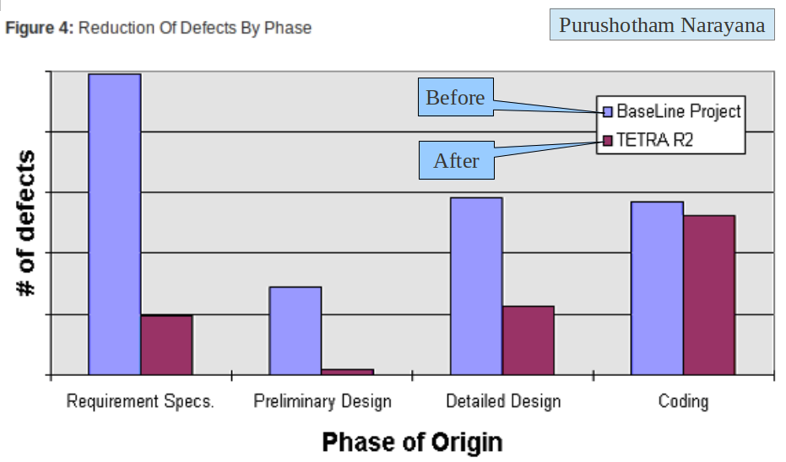
Why Defect Prevention 5 – Case Study
Notes:
CS5707 Software Development Paradigms
John Dawson
CS5707 Software Development Paradigms
John Dawson
CS5707 Software Development Paradigms
John Dawson

Slide 15
Why Defect Prevention 5?
... hence (in this case study) return on DP efforts in requirements has resulted in a large reduction of requirements related defects
DP is specifically identified as a level 5 KPA in the CMM – although good reason to consider DP “earlier”
Notes:
CS5707 Software Development Paradigms
John Dawson
CS5707 Software Development Paradigms
John Dawson
CS5707 Software Development Paradigms
John Dawson

Slide 16
Lecture Outline
What is Defect Prevention?
Why Defect Prevention?
Defensive Programming
Software Transformation
Notes:
CS5707 Software Development Paradigms
John Dawson
CS5707 Software Development Paradigms
John Dawson
CS5707 Software Development Paradigms
John Dawson

Slide 17
Defensive Programming
Coding Standards
Static Analysis
Software Inspections
Formal Methods
Examples
Notes:
CS5707 Software Development Paradigms
John Dawson
CS5707 Software Development Paradigms
John Dawson
CS5707 Software Development Paradigms
John Dawson

Slide 18
Why Coding standards?
80% of the lifetime cost of a piece of software goes to maintenance
Hardly any software is maintained for its whole life by the original author
Code conventions improve the readability of the software, allowing engineers to understand new code more quickly
If you ship your source code as a product, you need to make sure it is as well packaged and clean as any other product
Sun Microsystems, Inc
Notes:
CS5707 Software Development Paradigms
John Dawson
CS5707 Software Development Paradigms
John Dawson
CS5707 Software Development Paradigms
John Dawson

Slide 19
Coding standards: Examples
Naming conventions: Files / Identifiers
Layout: use of brackets & whitespace
Length of: Line / Method / Class / File
Comments: Layout / Content
Java Coding Standards
Notes:
CS5707 Software Development Paradigms
John Dawson
CS5707 Software Development Paradigms
John Dawson
CS5707 Software Development Paradigms
John Dawson

Slide 20
Static Analysis
Tools to detect possible defects
Supplements the compiler
Detects very specific problems e.g. variables used before initialisation, unreachable code, parameter mismatch
Early example: Lint (for C programs)
Notes:
CS5707 Software Development Paradigms
John Dawson
CS5707 Software Development Paradigms
John Dawson
CS5707 Software Development Paradigms
John Dawson

Slide 21
Software Inspections 1
More effective than testing, sometimes
A public (group) process
Offers a forum for knowledge transfer
Offers (more) opportunity for defect analysis
Pair Programming (XP) offers similar benefits?
Notes:
CS5707 Software Development Paradigms
John Dawson
CS5707 Software Development Paradigms
John Dawson
CS5707 Software Development Paradigms
John Dawson

Slide 22
Software Inspections 2
Disadvantages of Software Testing
In program execution, one bug can hide another
(Unit) testing can create need for temporary code (stubs / drivers)
Testing cannot check: style, standards compliance, readability and many other “-ilities”
Notes:
CS5707 Software Development Paradigms
John Dawson
CS5707 Software Development Paradigms
John Dawson
CS5707 Software Development Paradigms
John Dawson

Slide 23
Software Inspections 3
Disadvantages of Software Inspections
Can be a “hard sell”; is front-loaded i.e. additional effort earlier, to save (testing) effort later
Group, rather than solitary, so harder to arrange
Need to avoid the “blame game”
Notes:
CS5707 Software Development Paradigms
John Dawson
CS5707 Software Development Paradigms
John Dawson
CS5707 Software Development Paradigms
John Dawson

Slide 24
Formal Methods
Relies on a type of mathematical proof
Extremely expensive
Does not protect against specification errors / uncertainty
Proof itself may contain errors (Quis custodiet etc.)
Niche applications: Safety Critical
Notes:
CS5707 Software Development Paradigms
John Dawson
CS5707 Software Development Paradigms
John Dawson
CS5707 Software Development Paradigms
John Dawson

Slide 25
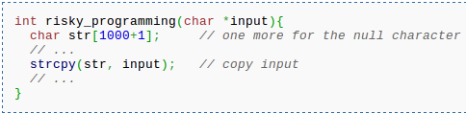
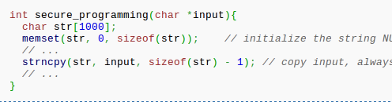
Defensive Programming: Example 1
Notes:
CS5707 Software Development Paradigms
John Dawson
CS5707 Software Development Paradigms
John Dawson
CS5707 Software Development Paradigms
John Dawson

Slide 26
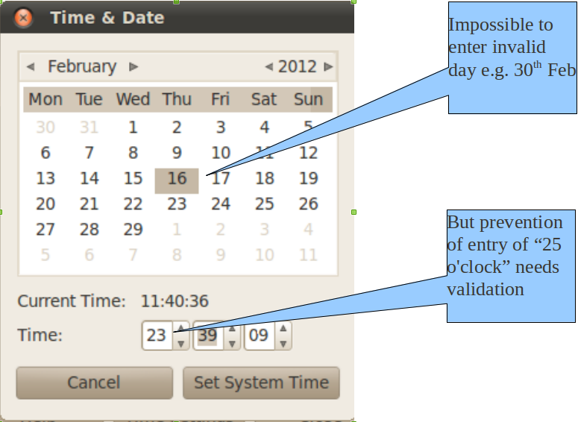
Defensive Programming: Example 2
Notes:
CS5707 Software Development Paradigms
John Dawson
CS5707 Software Development Paradigms
John Dawson
CS5707 Software Development Paradigms
John Dawson

Slide 27
Defensive Programming: Example 3/4
if (InVar = getc(input) != EOF)
if (InVar = (getc(input) != EOF))
if ((InVar = getc(input)) != EOF)
#define TRUE (1)
#define FALSE (0)
#define TRUE (1)
#define FALSE (!TRUE)

Slide 28
Lecture Outline
What is Defect Prevention?
Why Defect Prevention?
Defensive Programming
Software Transformation
Notes:
CS5707 Software Development Paradigms
John Dawson
CS5707 Software Development Paradigms
John Dawson
CS5707 Software Development Paradigms
John Dawson

Slide 29
Software Transformation: Taxonomy
Re-writing
Refactoring
Re-engineering
Notes:
CS5707 Software Development Paradigms
John Dawson
CS5707 Software Development Paradigms
John Dawson
CS5707 Software Development Paradigms
John Dawson

Slide 30
Refactoring 1
Code is modified more often than written
Most code is not only less than perfect, but also less than easily maintainable
Code quality can be introduced / recovered – one factoring at a time ...
Discipline: appropriate risk management
Classification: “Enabling change”- changes that add no functionality, but enable it
Automated testing and / or good tests a necessity
Notes:
CS5707 Software Development Paradigms
John Dawson
CS5707 Software Development Paradigms
John Dawson
CS5707 Software Development Paradigms
John Dawson

Slide 31
Refactoring 2
”By continuously improving the design of code, we make it easier and easier to work with. This is in sharp contrast to what typically happens: little refactoring and a great deal of attention paid to expediently adding new features. If you get into the hygienic habit of refactoring continuously, you'll find that it is easier to extend and maintain code”
Joshua Kerievsky, Refactoring to Patterns
Notes:
CS5707 Software Development Paradigms
John Dawson
CS5707 Software Development Paradigms
John Dawson
CS5707 Software Development Paradigms
John Dawson

Slide 32
Top Refactorings
Rename
Introduce Variable
Extract Method
Inline Variable
Inline Method
Move Method
Notes:
CS5707 Software Development Paradigms
John Dawson
CS5707 Software Development Paradigms
John Dawson
CS5707 Software Development Paradigms
John Dawson

Slide 33
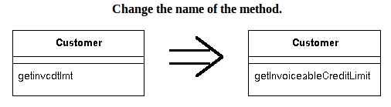
Refactoring: Rename Method
The name of a method does not reveal its purpose [clarification]
Notes:
CS5707 Software Development Paradigms
John Dawson
CS5707 Software Development Paradigms
John Dawson
CS5707 Software Development Paradigms
John Dawson

Slide 34
Refactoring: Introduce Variable
Complicated expression: put the result of the expression, or parts of the expression, in a temporary variable with a name that explains the purpose [clarification]
if ( (platform.toUpperCase().indexOf("MAC") > -1) &&
(browser.toUpperCase().indexOf("IE") > -1) &&
wasInitialized() && resize > 0 ) {
// do something
}
final boolean isMacOs = platform.toUpperCase().indexOf("MAC") > -1;
final boolean isIEBrowser = browser.toUpperCase().indexOf("IE") > -1;
final boolean wasResized = resize > 0;
if (isMacOs && isIEBrowser && wasInitialized() && wasResized) {
// do something
}
Notes:
CS5707 Software Development Paradigms
John Dawson
CS5707 Software Development Paradigms
John Dawson
CS5707 Software Development Paradigms
John Dawson

Slide 35
Refactoring: Extract Method
Turn the fragment into a method whose name explains the purpose of the method [clarification]
void printOwing() {
printBanner();
//print details
System.out.println ("name: " + _name);
System.out.println ("amount " + getOutstanding());
}
void printOwing() {
printBanner();
printDetails(getOutstanding());
}
void printDetails (double outstanding) {
System.out.println ("name: " + _name);
System.out.println ("amount " + outstanding);
}
Notes:
CS5707 Software Development Paradigms
John Dawson
CS5707 Software Development Paradigms
John Dawson
CS5707 Software Development Paradigms
John Dawson

Slide 36
Refactoring: Inline Variable
Replace all references to a temp with the expression [enables further refactoring ...]
double basePrice = anOrder.basePrice();
return (basePrice > 1000)
return (anOrder.basePrice() > 1000)
Notes:
CS5707 Software Development Paradigms
John Dawson
CS5707 Software Development Paradigms
John Dawson
CS5707 Software Development Paradigms
John Dawson

Slide 37
Refactoring: Inline Method
A method's body is just as clear as its name; put the method's body into the body of its callers and remove the method.
int getRating() {
return (moreThanFiveLateDeliveries()) ? 2 : 1;
}
boolean moreThanFiveLateDeliveries() {
return _numberOfLateDeliveries > 5;
}
int getRating() {
return (_numberOfLateDeliveries > 5) ? 2 : 1;
}
Notes:
CS5707 Software Development Paradigms
John Dawson
CS5707 Software Development Paradigms
John Dawson
CS5707 Software Development Paradigms
John Dawson

Slide 38
Refactoring: Move Method
A method is using more features of another class than the class on which it is defined. Create a new method with a similar body in the class it uses most.
class Project {
Person[] participants;
}
class Person {
int id;
boolean participate(Project p) {
for (int i=0; i<p.participants.length; i++) {
if (p.participants[i].id == id) return(true);
}
return(false);
}
}
... if (x.participate(p)) ...
class Project {
Person[] participants;
boolean participate(Person x) {
for (int i=0; i<participants.length; i++) {
if (participants[i].id == x.id) return(true);
}
return(false);
}
}
class Person {
int id;
}
... if (p.participate(x)) ...

Slide 39
Refactoring: Example
Refactoring 1 of 5 - 4:00
Refactoring 2 of 5 - 0:00
Refactoring 3 of 5
Refactoring 4 of 5
Refactoring 5 of 5 - 6:30

Slide 40
Reading
Humphrey, Watts (1990) Managing the Software Process (recommended text), chapter 17
Galin, Daniel (2003) Software Quality Assurance: From Theory to Implementation (recommended text), chapter 7 (end of)
Fowler, Martin (1999) Factoring: Improving the Design of Existing Code; see also http://martinfowler.com/refactoring/
Notes:
CS5707 Software Development Paradigms
John Dawson
CS5707 Software Development Paradigms
John Dawson
CS5707 Software Development Paradigms
John Dawson

Slide 41
Next Few Sessions
Mon 26th Mar: Project Tutorial – as required
Thu 29th Mar: No lecture – FYP Demo Day
Mon 9th Apr: Project Interim Presentations
Notes:
CS5707 Software Development Paradigms
John Dawson
CS5707 Software Development Paradigms
John Dawson
CS5707 Software Development Paradigms
John Dawson

